Slide 1
Identifying and Reducing Customer Churn in Banking Project Charter
5/19/2020

Slide 2
Project Description & Scope
Project Description: AWP Bank is looking to improve upon a key performance indicator of customer retention. As a result, AWP Bank has hired MLC Consulting in order to 1.) predict customers who are likely to churn, 2.) identify strong predictors of churn, and 3.) provide suggestions on how to reduce the churn rate. These deliverables will be the result of applying and fine-tuning machine learning algorithms to a dataset provided by AWP Bank and interpreting the results for key decision makers and leadership.
Scope: The scope of this project includes reviewing and analyzing the dataset. Data cleaning steps such as imputing or removing miss values and removing highly stable, irrelevant, or redundant features. New features may be added to the dataset. An iterative approach will be taken to evaluate candidate models, fine tune parameters, and evaluate model performance. Once a model has been chosen and an acceptable level of performance has been obtained, the production dataset will be included in the modeling process to generate predictive labels, variables of importance will be evaluated to determine possible steps for reducing churn in the individuals identified as probable churners. The software used to accomplish this project will be RapidMiner.

Slide 3
Sponsors, Stakeholders and Roles & Responsibilities
Sponsors: The Vice President of Operations at AWP Bank is the main sponsor of this project. In addition the Manager of Customer Service acts as a secondary sponsor.
Stakeholders: AWP Bank as whole is a stakeholder of this project, though internally the Vice President of Operations and the staff under the Customer Service division will benefit more greatly from the results of this project. Externally, customers of the bank and AWPs competitors could be potential stakeholders as well without knowing it. Existing customers may benefit from increase customer satisfaction convincing he/she to continuing doing business at AWP Bank and an opportunity is lost by a competitor.
Roles & responsibilities: The aforementioned individuals at AWP will be available to provide information, including the dataset, to MLC Consulting. MLC Consulting will provide analysis using data science concepts and techniques to bring insights in regards to customer churn.

Slide 4
Business Case
Business Problem: AWP Bank is re-evaluating their key performance indicators. Leadership has determined that customer retention is an important metric to maximize. As a result, the bank wants to analyze what makes clients churn and who will most likely be ones to churn. As a result of the analysis, AWP Bank along with the assistance of MLC Consulting will be able to derive actionable insights that advise the probability of customers who will churn in the production dataset (who to engage in to reduce churn) and what the strongest predictive features are of these clients.
Benefits: Increasing customer retention means that the bank will keep customers for a longer time allowing them to grow their customer base. Over the lifetime of their clients’ lives, each individual experience a banking need whether it be financing student loans, purchasing a home, starting a college fund for children, investing in different CDs/saving accounts etc. Retaining customers allows AWP Bank to serve their customers during this time instead of giving the business to their competitors. In addition, the larger the customer base, the larger the amount of funds AWP Bank to distribute loans earning interest while paying their customer’s savings account a lower interest rate. The average customer makes the bank $5,000 per year.
Budget: AWP Bank has engaged in a $25,000 fixed project cost with MLC Consulting for the three-month project. The VP of Operations has the authority to approve additional expenses up to an additional $25,000.

Slide 5
Key Milestones & Deliverables
Summary of all top level and subordinate products and services whose full delivery and acceptance are critical to the successful completion of the project. Include any critical deliverables to be performed by external organizations
Define key project milestones, deliverables and planned finish dates
The following is a summary of the key deliverables for the project.
Month 1 – Business and Data Understanding:
Data set for the machine learning project
Early prototype to assess candidate models
Review data for data quality, missing values, and outliers
Month 2 – Iterate through Modeling, Identify best model:
Finalize project dataset with only moderate to strong predictors of the target column, remove redundant features, and/or create new features
Identify the best model engine for the dataset
Fine tune the model through hyper parameters
Apply a clustering method to identify market segments
Month 3 – Interpret Results:
Supply a list of the top 100 customers most likely to churn
Provide a summary of the most important variables
Provide a report of recommended actions to reduce churn
Construct a profile of customers likely to churn
Provide advice of possible deployment opetions

Slide 6
Critical Success Factors & Risks
Critical Success Factors:
A model with an AUC greater than .6 must be produced.
Risks Constraints & Assumptions
It is assumed that the data set contains moderate to strong predictors of the target.
Risk Impact
Project Size: Medium
Change Management: Medium
Infrastructure Need: None

Slide 7
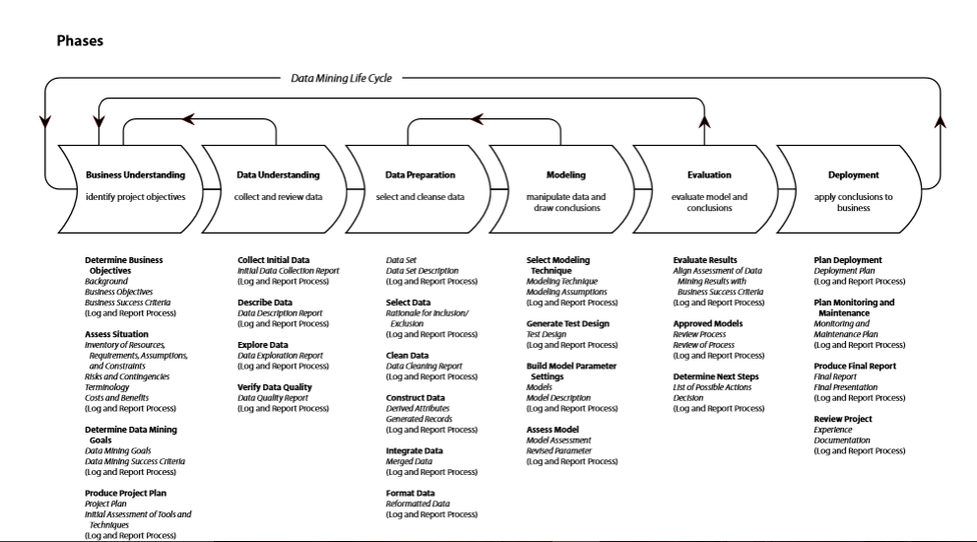
CRISP-DM Project Methodology with Deliverables

Slide 8
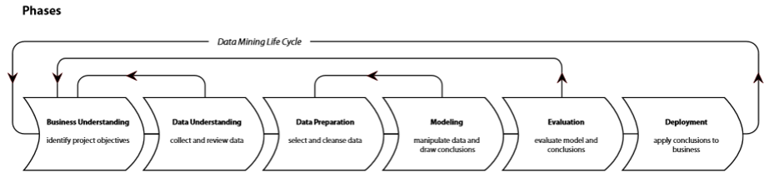
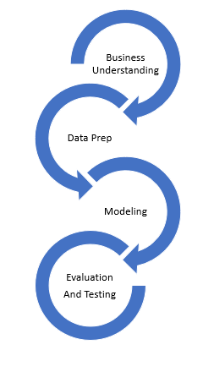
Example of An Agile Life Cycle Implementation
Prototype & Open Questions
Prototype & Open Questions
Deliverable is a report
Deliverable is a workbook
Deliverable is a web service
Action
Action
Action

Slide 9
SPIRAL CHART
Cumulative cost
Progress through steps
1.Determine
objectives
2. Validate Value Props and Identify/ Resolve Risks
Risk analysis
Commitment partition
Risk analysis
Risk analysis
Risk
analysis
Operational Prototype
Prototype 1
Prototype 2
Review
Emulations
Rqts Plan
Life cycle
plan
Concepts of require-
ments
Models
Benchmarks
Requirements
Product
design
Detailed
design
Development plan
Requirements
validation
Code
Integration and test plan
Design validation
And verification
Unit test
4. Plan the next iteration
Integration
3. Development and Test
Test
Implementation

